Slide 1
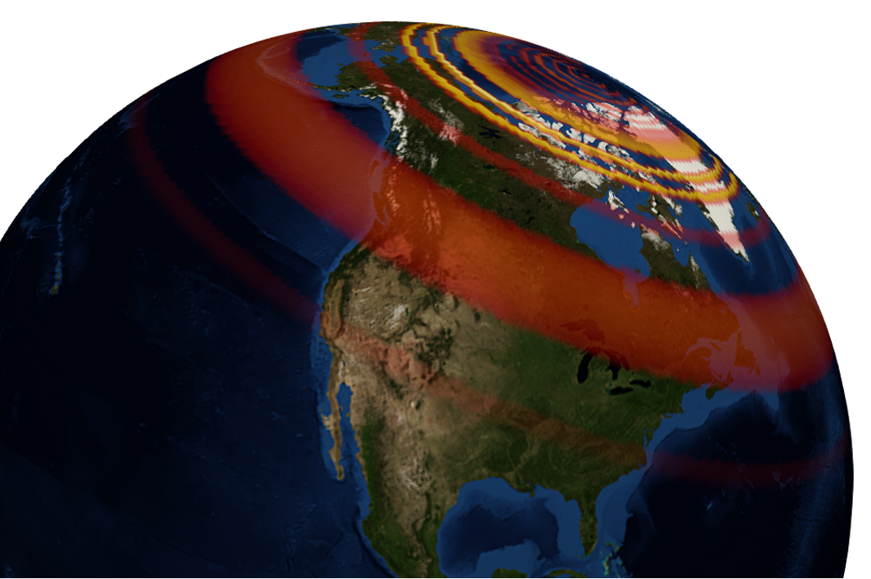
GEOL593: Seismology and Earth Structure, Spring 2023
Lecture 7: Seismic Tomography
3/2/23
Ross Maguire
rossrm@illinois.edu
3014 NHB

Slide 2
Class schedule
 | Dates | Topic | Lab assignment
Week 1: | Jan 17, Jan 19 | Course overview | Lab 1: Python crash course
Week 2: | Jan 24, Jan 26 | Seismic signal processing | Lab 2: Introduction to Obspy
Week 3: | Jan 31, Feb 2 | Moment Tensors/ Inverse methods | Lab 3: Moment tensor inversion
Week 4: | Feb 7, Feb 9 | 🤮 No class, Ross ill | Seismic wave propagation 1
Week 5: | Feb 14, Feb 16 | Lab 4: Reference Earth models: The “1D” Earth | Seismic wave propagation 2
Week 6: | Feb 21, Feb 23 | Lab 5: Surface wave dispersion | Surface waves and normal modes
Week 7: | Feb 28, Mar 2 | Lab 6: Normal modes | Imaging Earth Structure 1: Seismic tomography
Week 8: | Mar 7, Mar 9 | Lab 7: Seismic Tomography | Imaging Earth Structure 2: Seismic discontinuities / Research paper discussion
Week 9: |  | Spring break
Week 10: | Mar 21, Mar 23 | Lab 8. Receiver Functions | Anisotropy and anelasticity
Week 11: | Mar 28, Mar 30 | Planetary seismology 1 | Lab 9: InSight- Seismology on Mars
Week 12: | Apr 4, Apr 6 | Planetary seismology 2
Week 13: | Apr 11, Apr 13 | Machine learning in seismology 1 | Lab 10: Earthquake detection
Week 14: | Apr 18, Apr 20 | Machine learning in seismology 2
Week 15: | Apr 25, Apr 27 | Frontiers of seismology: What’s next?
Week 16: | May 2, May 4 | Research paper presentations

Slide 3
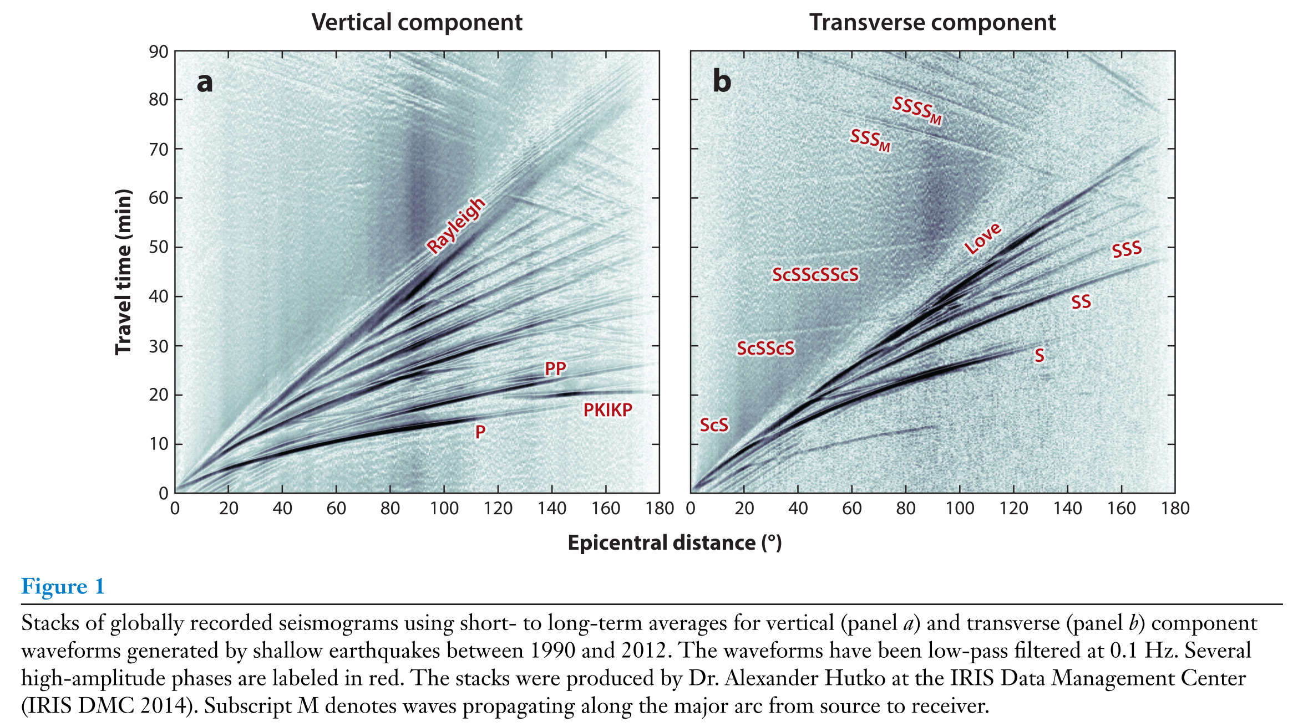
Seismic tomography: Moving beyond ‘1D’ models
1D models (e.g., PREM) do a very good job of explaining global travel time data
For teleseismic body waves, travel time observations typically only deviate from 1D predictions by ~10 s or less (e.g., only several % variation)
Mapping out the places where the Earth is seismically faster/ slower than average gives great insight into the dynamics of the interior!
Ritsema and Lekic, 2020

Slide 4
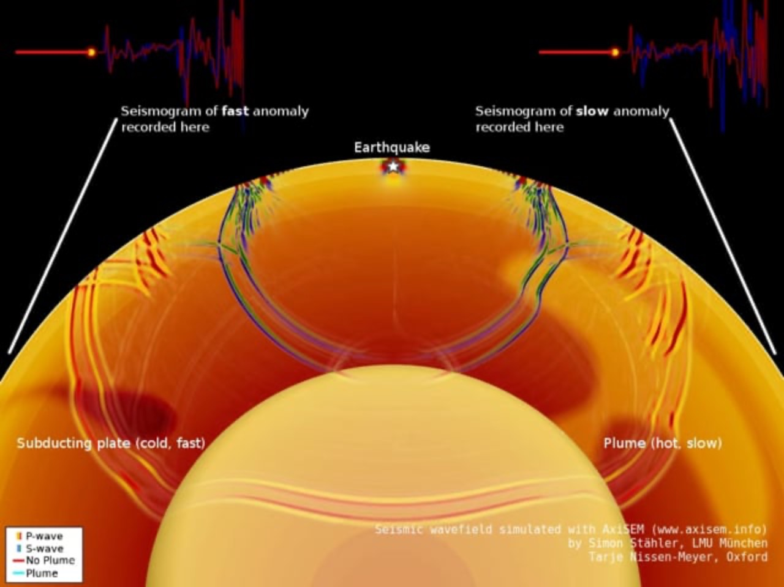
Courtesy of Simon Stahler

Slide 5
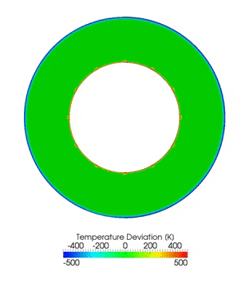
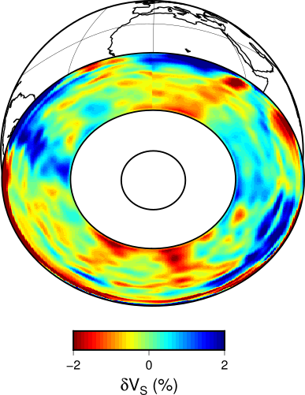
Global Tomography: Linking Seismic Images to Mantle Dynamics
S40RTS
Ritsema et al., 2011
Courtesy of
Rene Gassmöller

Slide 6
Seismic tomography primer
Simple tomography example: two rays sample a 9 parameter model
Model vector
Data vector
Forward theory
ray1
*
ray 1 takes 3.5 s
ray 2 takes 2.5 s
m1
m2
m3
T
d = [ 3.5 2.5 ] travel time in seconds
m4
m5
m6
[
]
G = 1 1 1 0 0 0 0 0 0
1 0 0 1 0 0 1 0 0
m7
m8
m9
*
ray2

Slide 7
Types of Inverse Problems
Even-determined problems
Same number of model parameters (i.e., ”unknowns”) as data
Unique solution (if no observational error exists)
Over-determined problems
More data than model parameters
Best solution based on minimizing some measurement of misfit (e.g., least-squares misfit)
Under-determined problems
More model parameters than data (or some model parameters not constrained by data)
Infinitely many solutions exist. Must choose a solution by adding constraints (e.g., independent information)
Mixed-determined problems
Some model parameters are over-determined, some are unconstrained
Infinitely many solutions

Slide 8
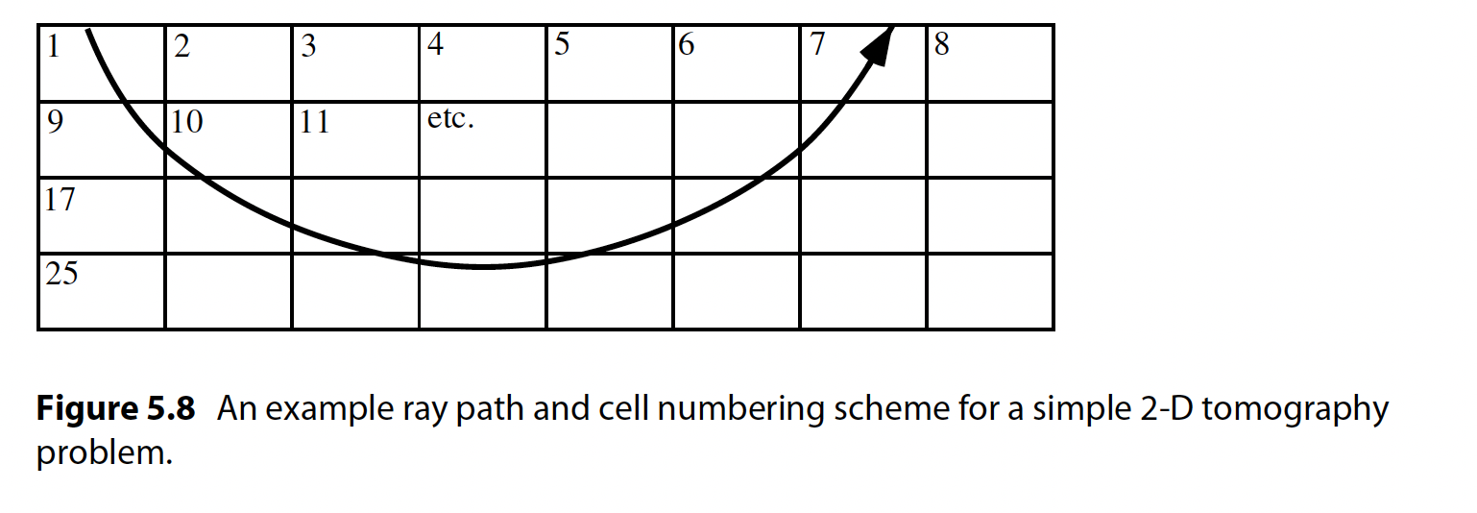
Travel time tomography (ray-based)
v(s) = velocity at point s along the ray path
u(s) = 1/v(s) = “slowness”
G_{ij} is the distance that the i^{th} ray travels in the j_{th} block
or
Relative travel time tomography:

Slide 9
Least squares solution
requires G^{T}G to be invertible
What happens if G^{T}G is not invertible?
There are infinite number of solutions! (You can add to the solution, any solution in the ‘nullspace’ of G^{T}G).
We need to impose some extra conditions on the solution to solve it.

Slide 10
Regularization: Norm damping
Need to introduce prior knowledge of the model m
One choice is to find the m that is closest to a reference model m₀. If you are inverting for model perturbations, the reference might be 0.
Biases model parameters towards reference (e.g., 0)
Quantity to be minimized
𝛌 controls how strongly to apply ‘prior’ information
Damped least squares solution

Slide 11
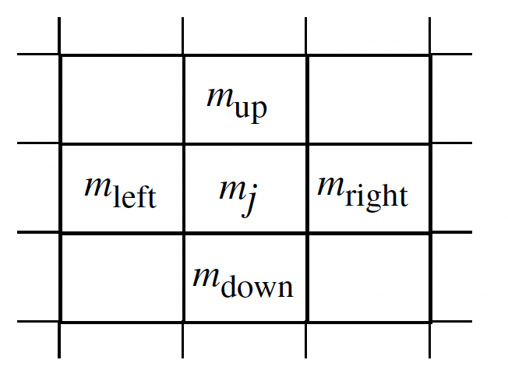
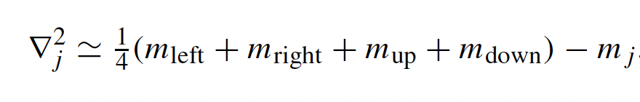
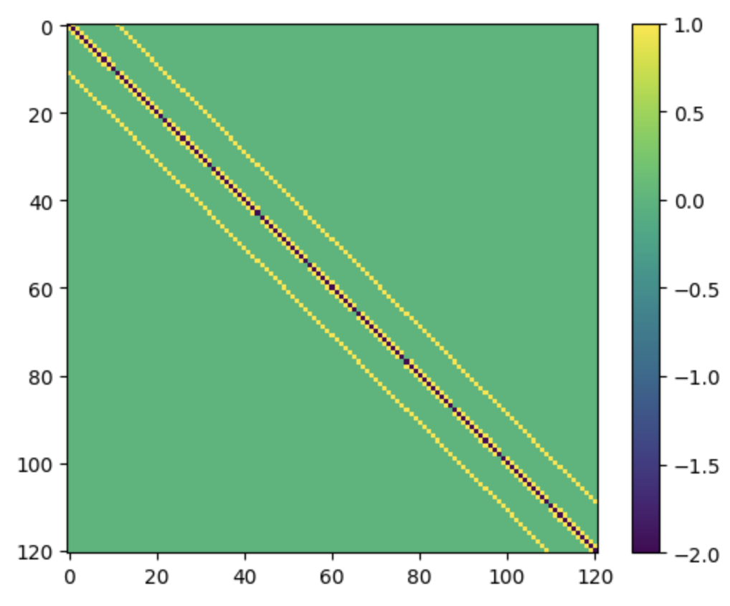
Regularization: Smoothing
Minimize the ‘roughness’ of the model

Slide 12
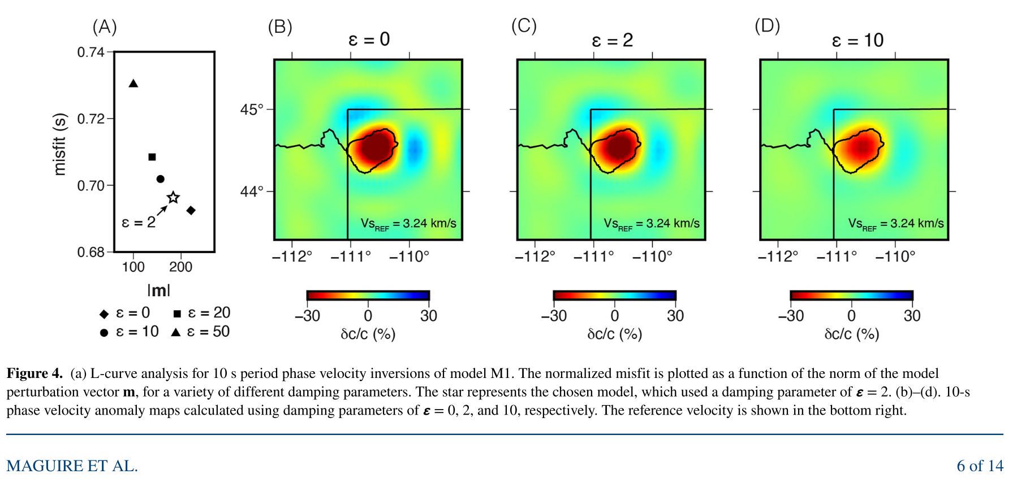
How to choose damping parameters? (L-curve test)
An ‘optimal’ choice for a regularization parameter is often the one that provides a balance between model ‘size’ and misfit.
This will be near the bend in an ‘L-curve’ plot

Slide 13
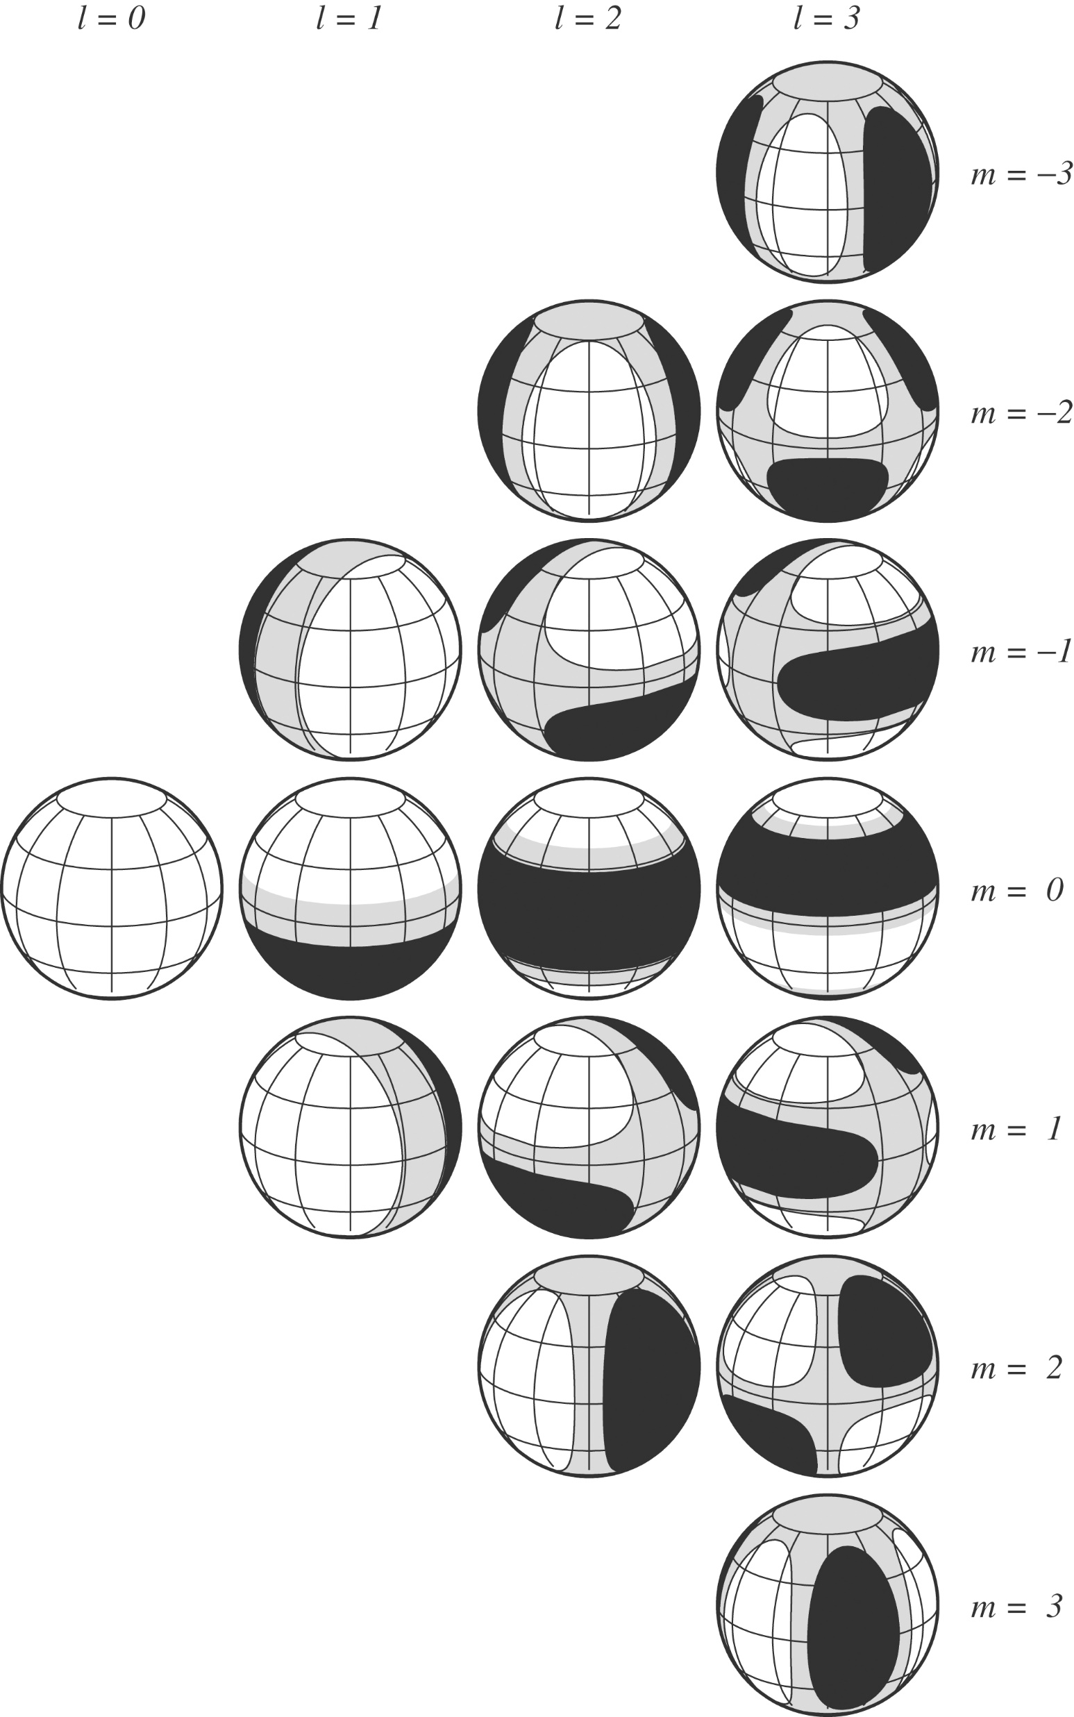
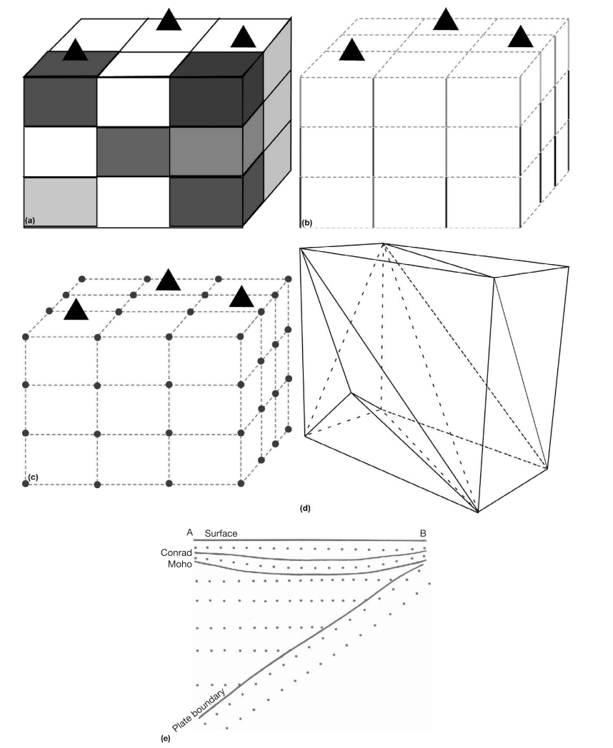
Model parameterization
Blocks
Nodes
Tetrahedra
Spherical Harmonics
Etc…

Slide 14
Model resolution
We can explore the resolution of a tomographic model by testing how various input structures (left) would appear given the coverage provided by our dataset (i.e. ray geometry)

Slide 15
Smearing
When only a limited range of ray angles are available, structures are smeared in the direction parallel to the rays

Slide 16
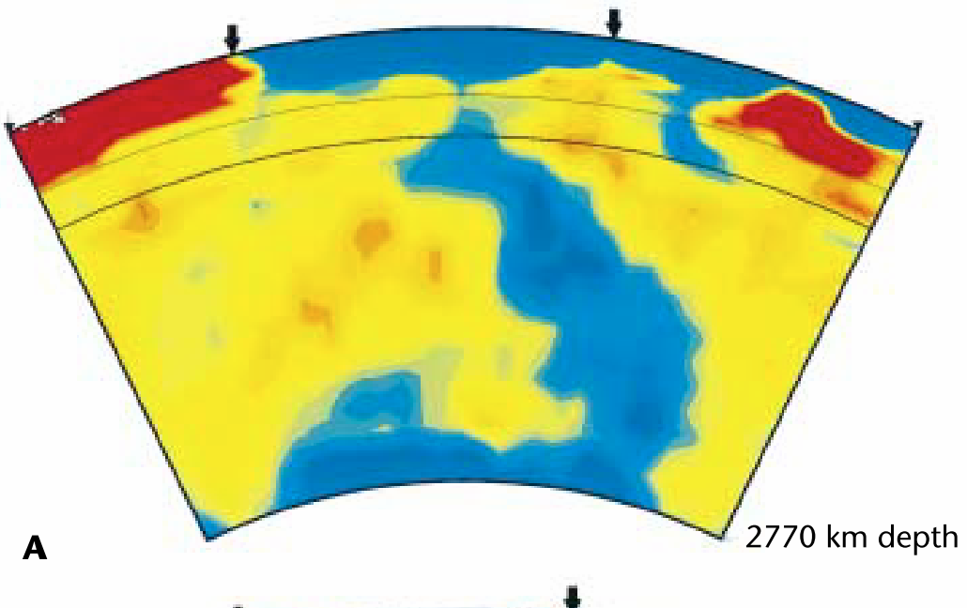
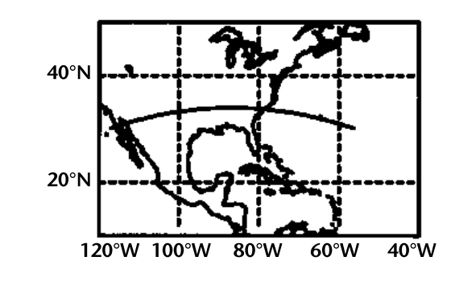
Subduction zone tomography
Do slabs penetrate the transition zone? (In mantle convection layered?)
Grand et al., 1997

Slide 17
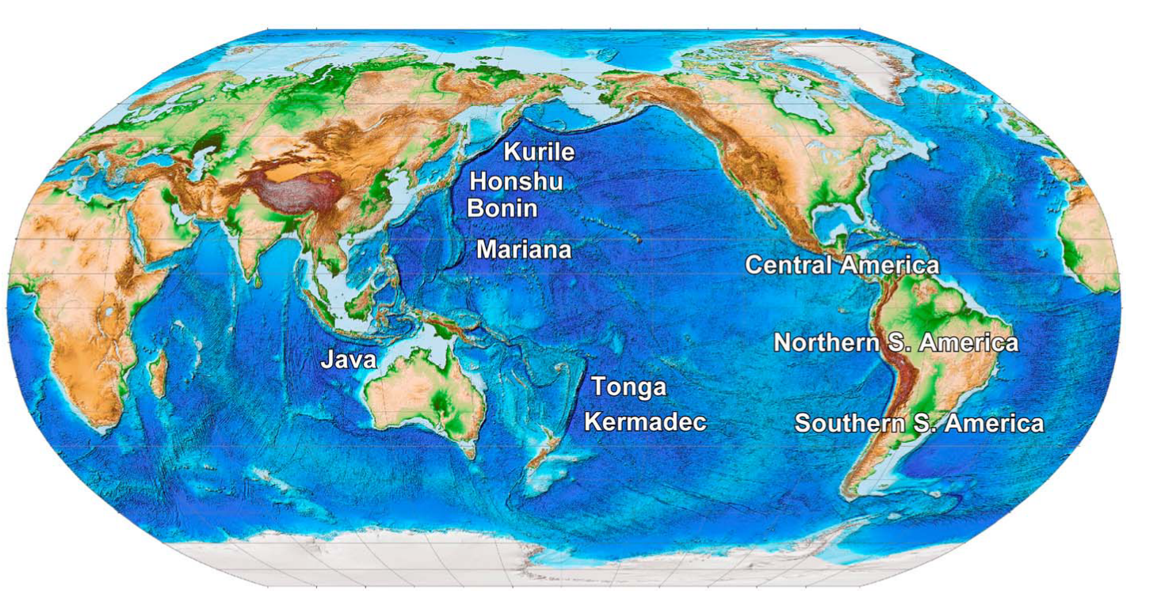
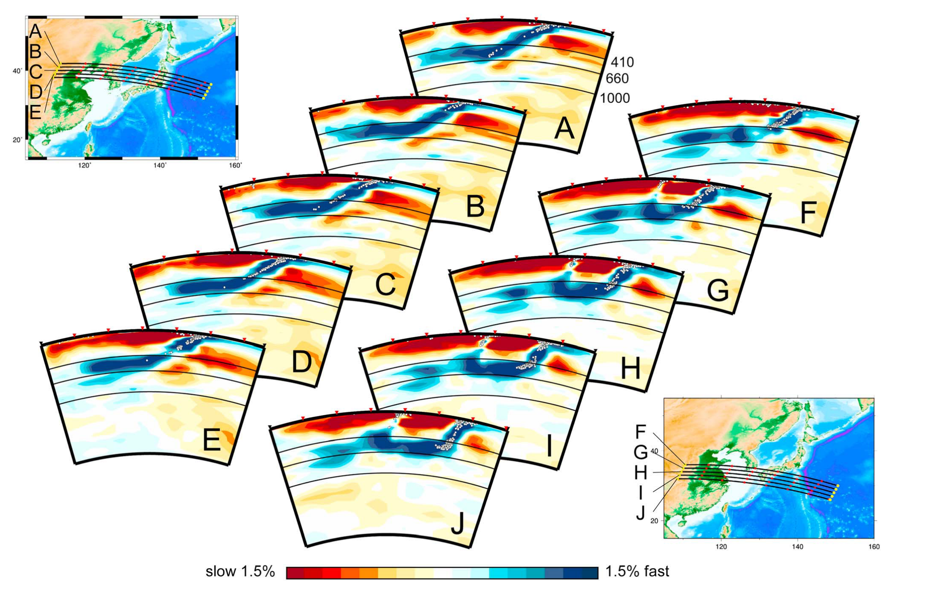
Slabs stagnating in the transition zone
Fukao & Obayashi, 2013

Slide 18
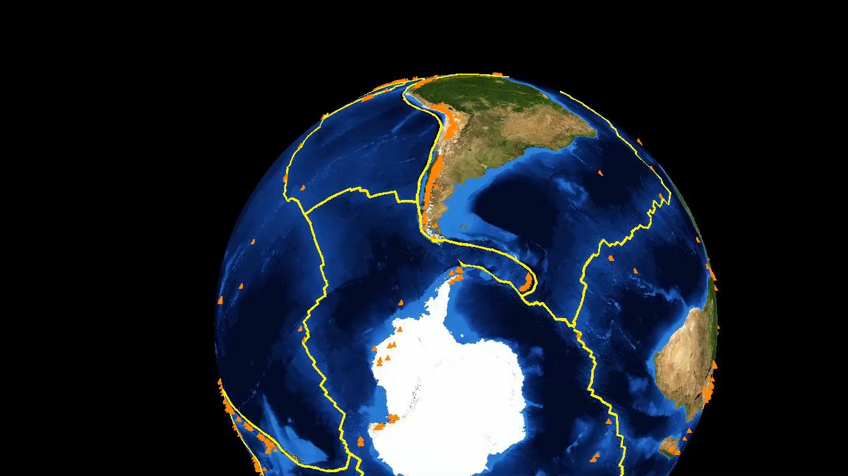
Global P-wave travel time tomography

Slide 19
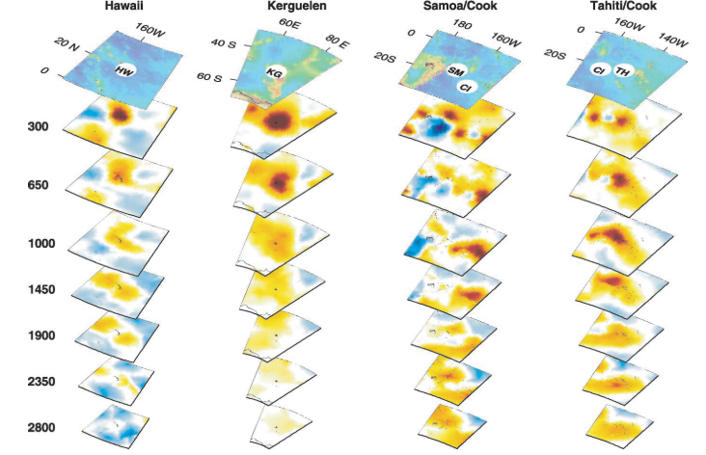
Hotspots and mantle plumes
Montelli et al., 2006

Slide 20
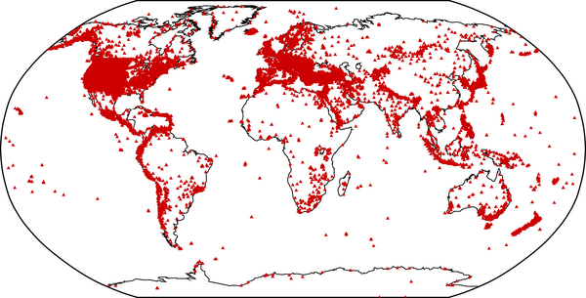
Limitations of plume imaging
Data coverage (stations mostly on continents)
ISC stations

Slide 21
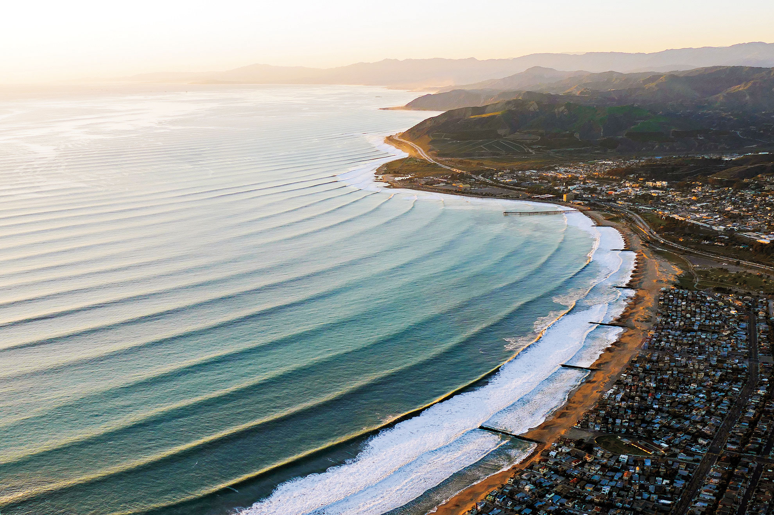
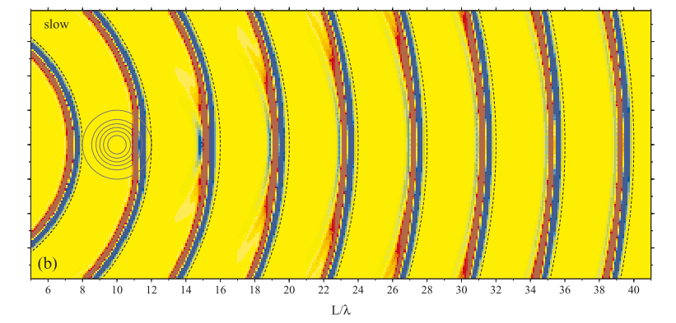
Limitations of plume imaging
Data coverage (stations mostly on continents)
ISC stations
Plumes are narrow and deep
Wavefront healing (wave delays don’t survive)

Slide 22
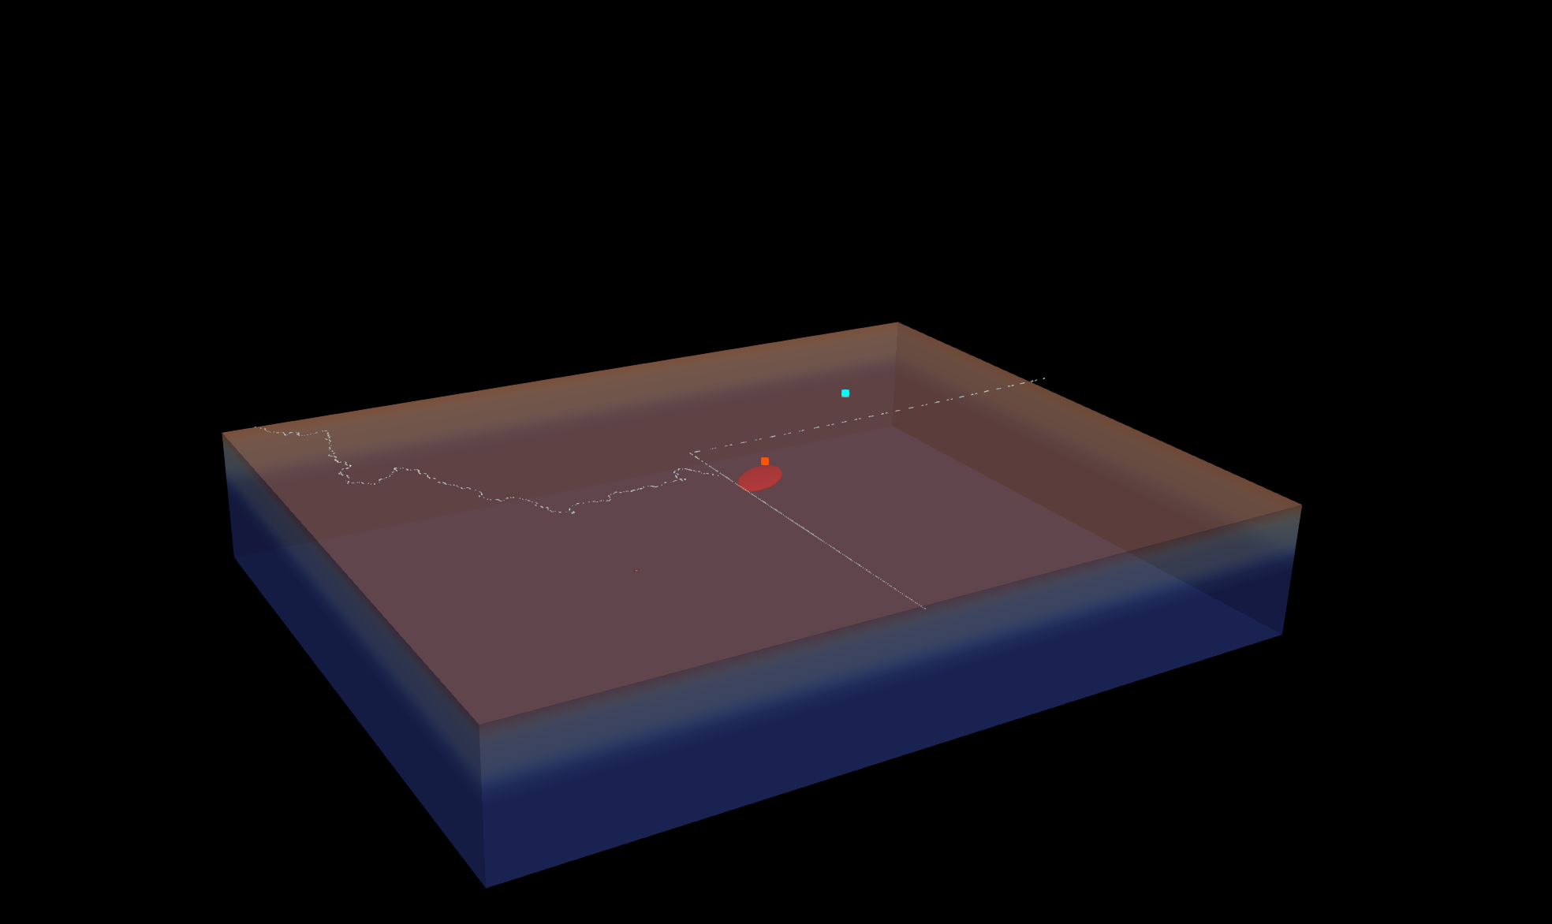
station 2
station 1
source
dVs = -66%

Slide 23
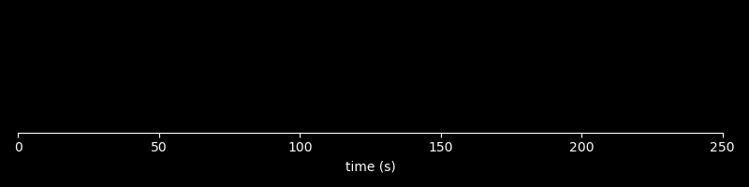

station 1
station 2
with anomaly
with anomaly
without anomaly
without anomaly
dVs = -66%

Slide 24
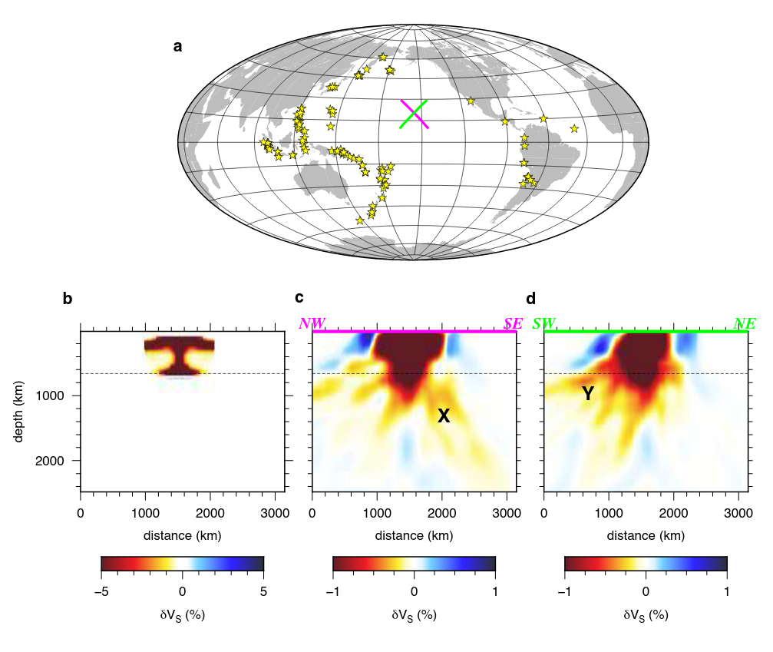

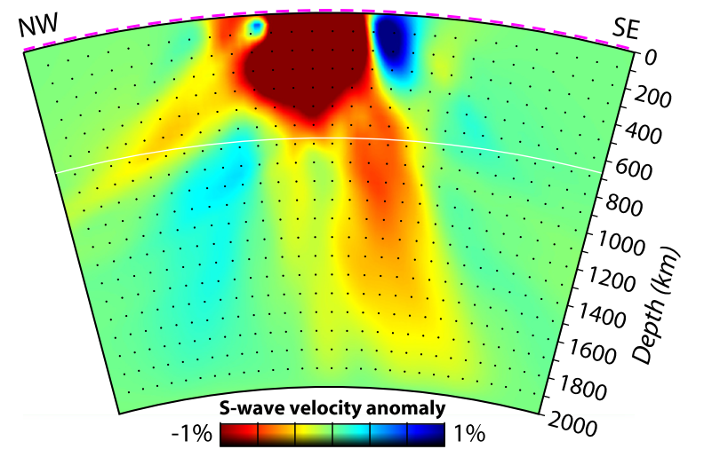
Phantom plume tails?

Slide 25
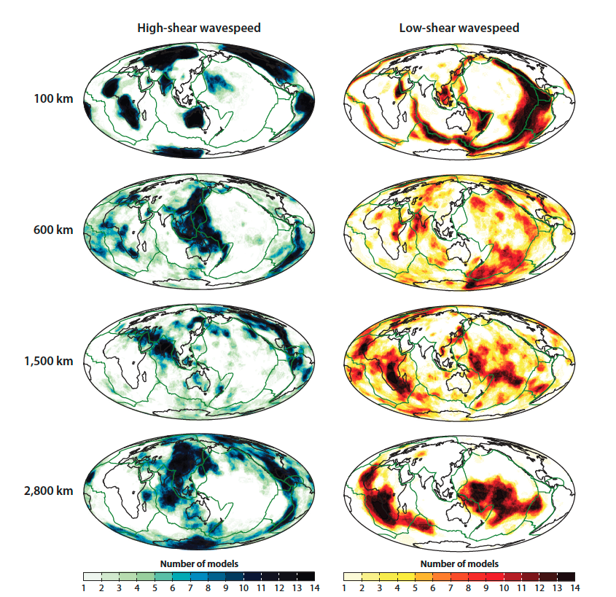
Ritsema and Lekic, 2020

Slide 26
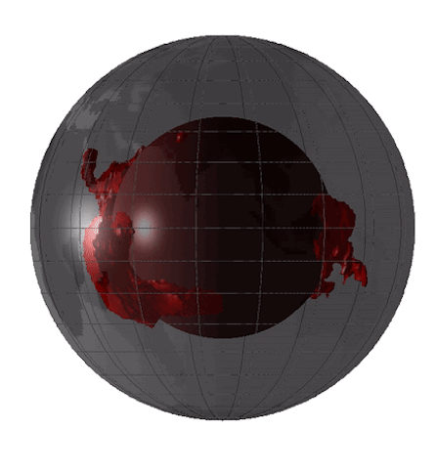
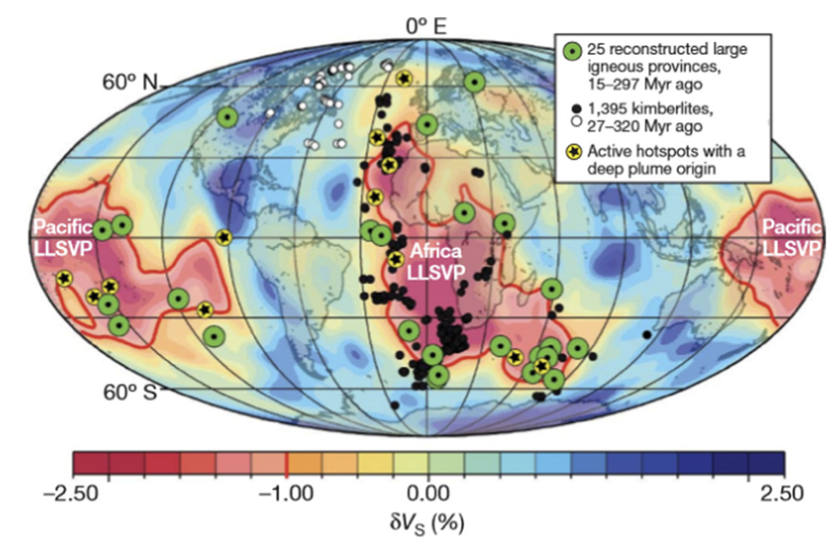
Large Low Shear Velocity Provinces (LLSVPs)
Torsvik et al., (2010)

Slide 27
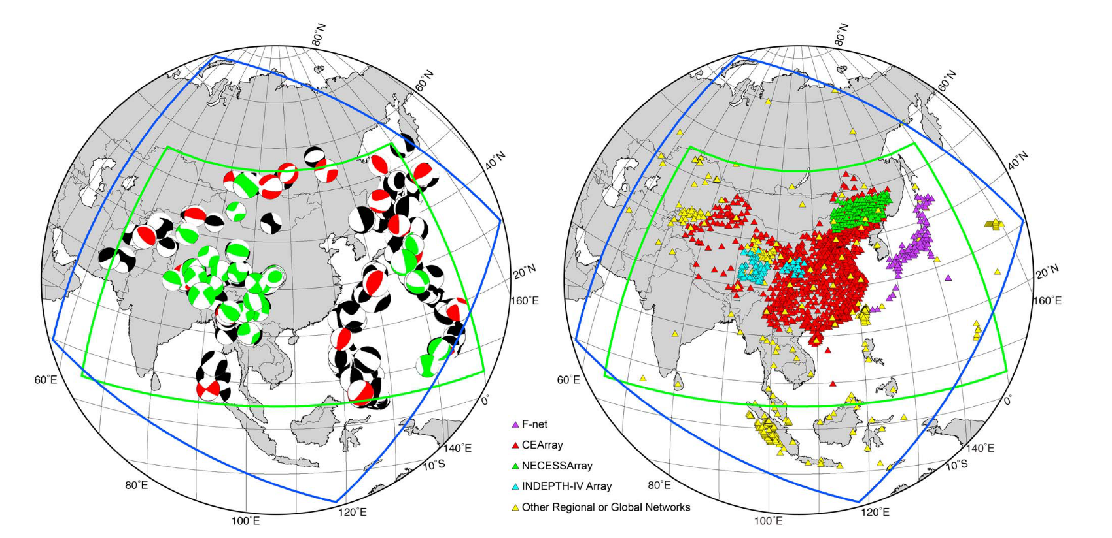
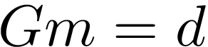
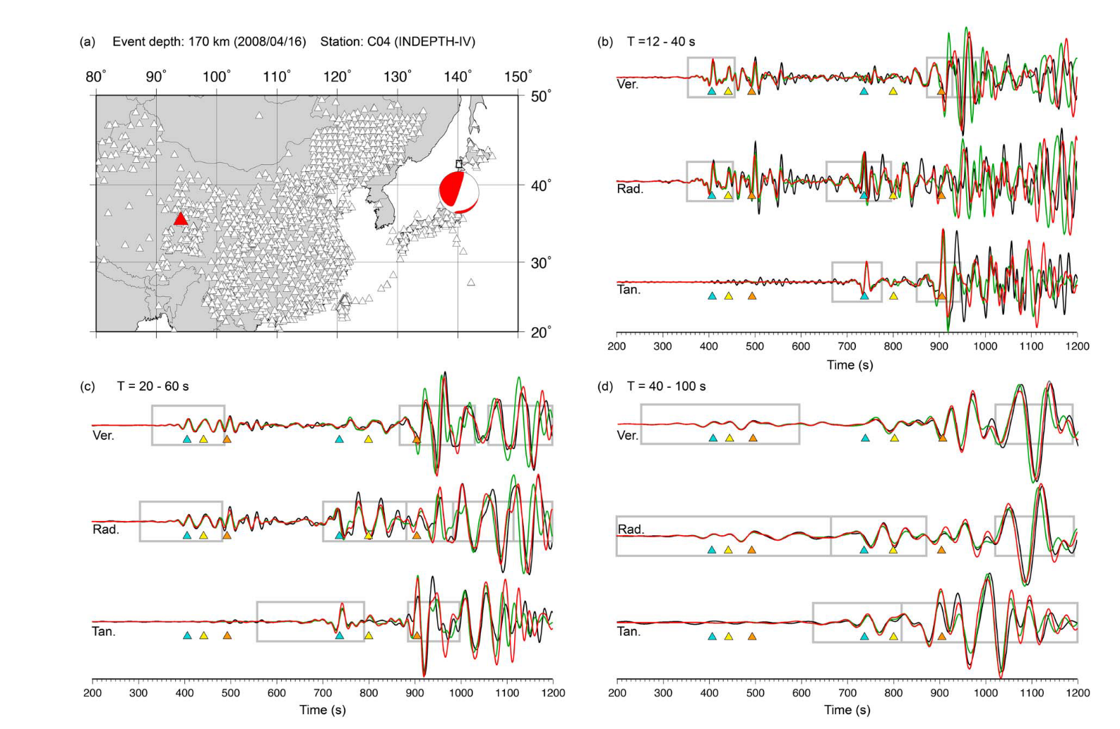
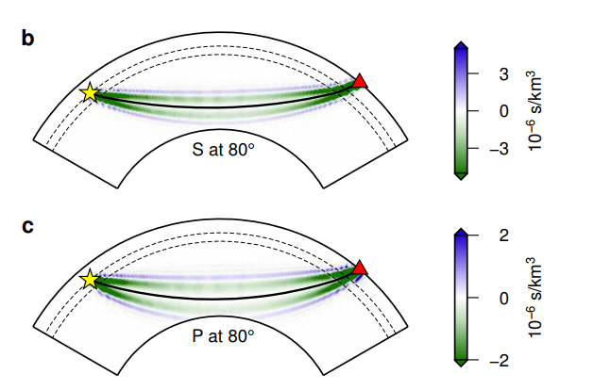
Beyond ray theory
Finite frequency theory
“Full waveform” tomography
forward theory
model
data
Lines: ray paths
Colored regions: finite frequency kernels
Chen et al., 2015

